Slide 1

SRIT NSS WEBPORTAL
Batch No: A-13 Project Guide:
K.Lakshmi Prasanna 164G1A0546 Mr. G.Chinna Pullaiah , M.Tech, (Ph.D)
S.V.Manasa 164G1A0551 Assistant Professor
K.Bhargava 164G1A0512
K.Ganga Raju 174G5A0501
GitHub https://github.com/A-13nsswebportal
Srinivasa Ramanujan Institute of Technology
Department of Computer Science & Engineering

Slide 2
Abstract…
In this project we are implementing all the mandatory fields required for the national service scheme website.
Till now we don't have a proper website for NSS in our college. The NSS plays major role to provide with rich and meaningful educational experiences to them in order to make their education complete and meaningful.
Now we are developing a NSS website where the student can see the details of the latest events and register with the upcoming events and can also learn about the national wide news about the NSS website.

Slide 3
Contents
Problem Definition.
Literature Survey.
Modules.
Design.
Implementation.
Tool and Technologies.
References

Slide 4
Problem Statement
To provide an interactive interface for the organization and to store all the events regarding NSS .

Slide 5
Literature Survey
Existing System
https://sites.google.com/srit.ac.in/nss
The website contain only the list of Events/Activites and it does not contain the detailed information about the event like where the event happened, who attended the event, motto of the event and photos of the event etc.
The existing system don’t have the student registration portal, upcoming events details and their registrations.

Slide 6
Proposed System
The proposed system should overcome the drawbacks of the existing system.
Working of our proposed model includes Student registrations for the upcoming events
The full details about the events occurred and the events going to happen and these website also include some special tabs which will help the students not only attend to the events in the college but also the events occur in different colleges so that they can register and participate in it.
Proposed model also contain the details of the events happened in past years and also can generate a progress report about the events.

Slide 7
Modules
NSS Co-ordinator:
Login
Selecting programs/what’s new
Updating the event details, uploading photos and Latest news
Updating Data Base.
Logout
NSS Volunteers:
Login
Uploading photos
Logout

Slide 8
Contd…
Students:
Logon to website
Viewing the updated posts
Register for latest events

Slide 9
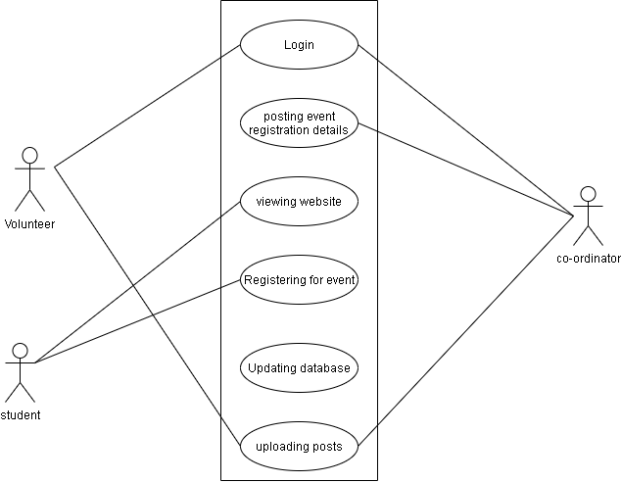
Usecase Diagram

Slide 10
Implementation
Software Required:
Python
Flask Tool
PostgreSQL

Slide 11
Contd…
Python: It is used to create for developing of code.
Flask Tool: It is a web framework. This means flask provides you with tools, libraries and technologies that allow you to build a web application.
PostgreSql:It is used to create tables in Database.

Slide 12
Tools
Tools Used:
Flask Tool
Hardware Requirements:
RAM
Hard Disk
Programming Languages:
Python (Middleware)
Hyper Text Markup Language (HTML-Frontend)

Slide 13
Requirements
Hardware Requirements:
Processor
RAM
Operating System: Windows7/8/10
HardDisk:1TB
Software Requirements:
Frontend: HTML,CSS &Bootstrap
Backend: postgreSQL
Middleware: python(Flask)
Interface:Sqlalchemy

Slide 14
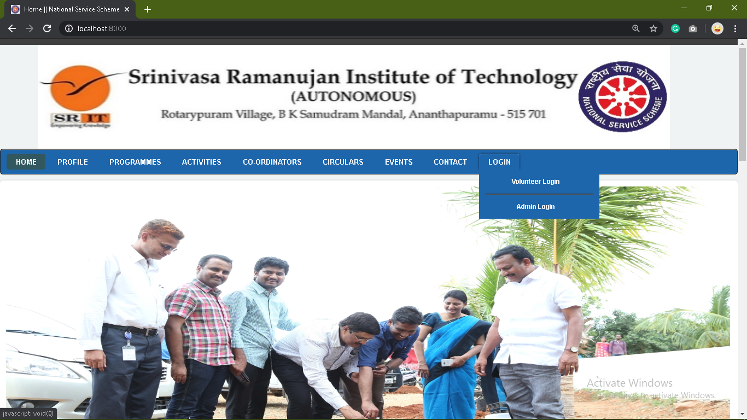
Home Page:

Slide 15
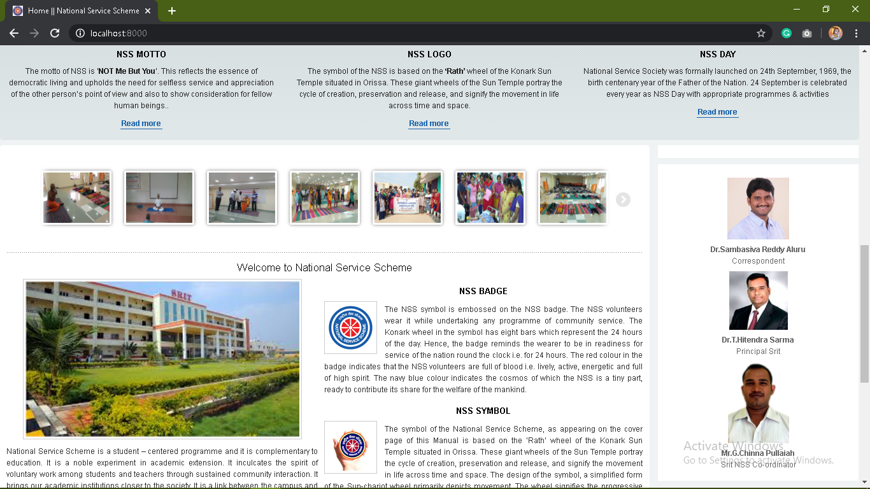
Contd…

Slide 16
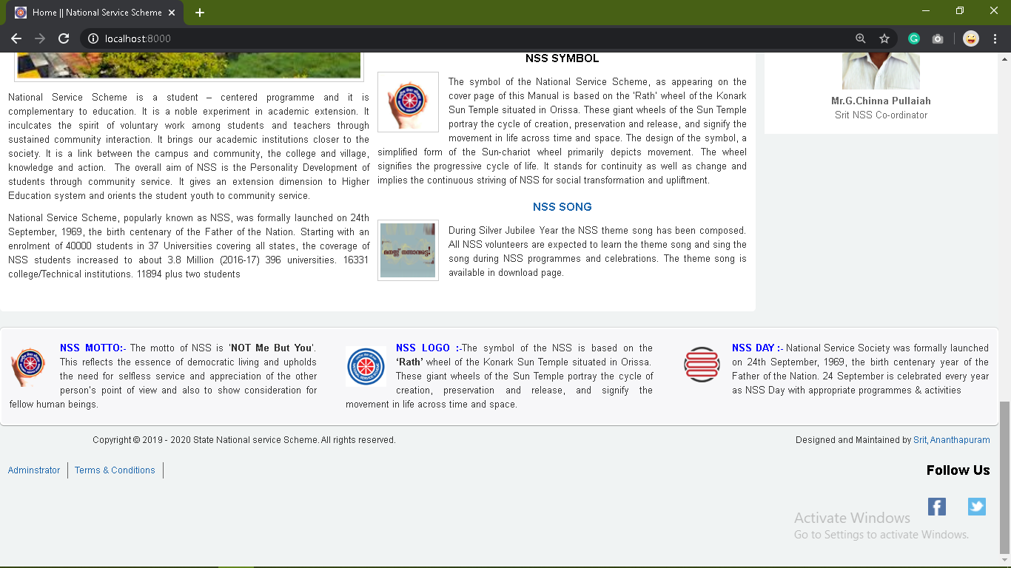
Contd...

Slide 17
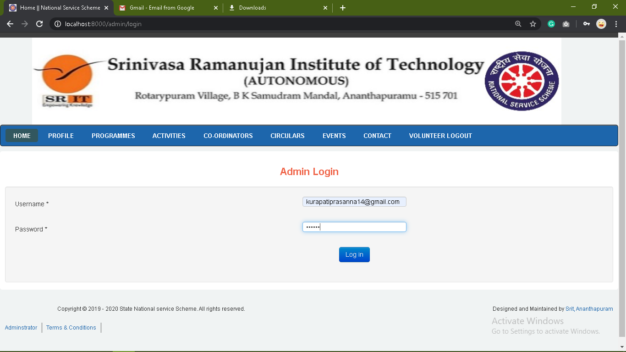
Admin Login Page:

Slide 18
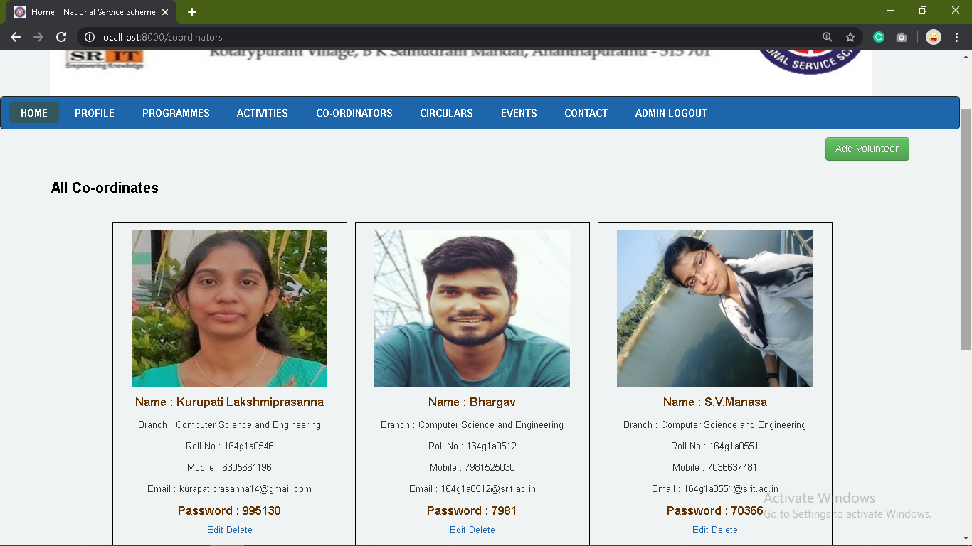
Admin-Add volunteer

Slide 19
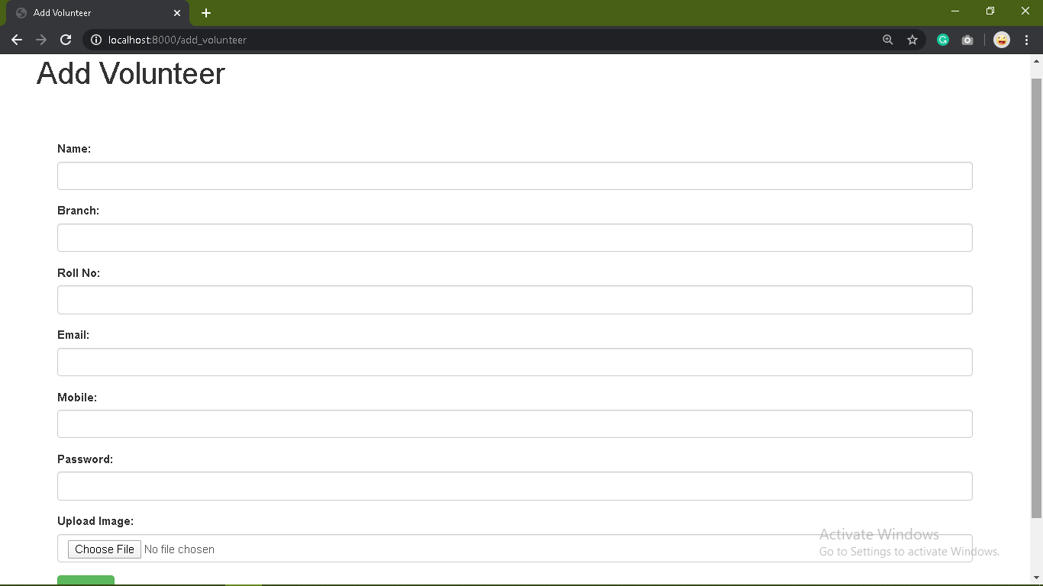
Cont...

Slide 20
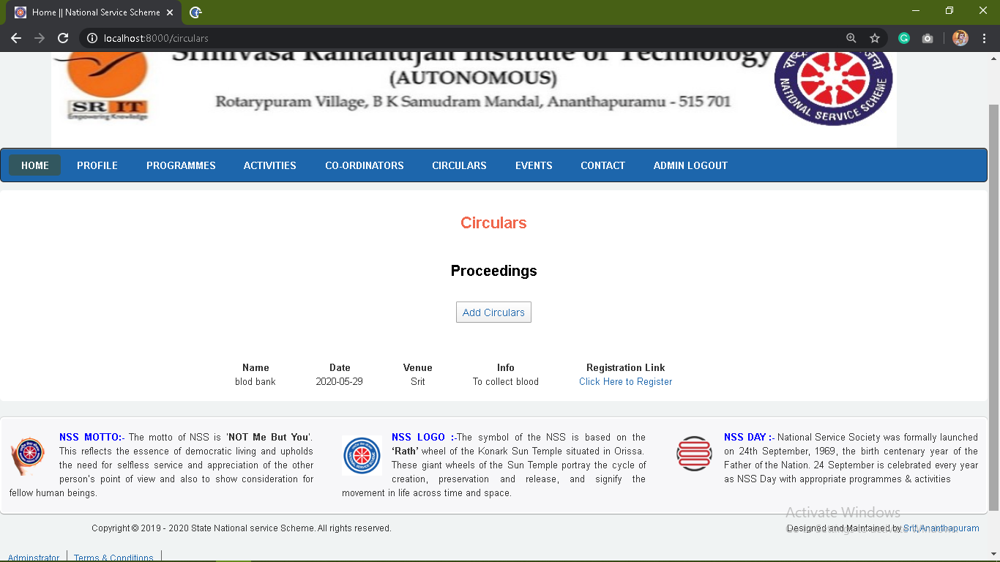
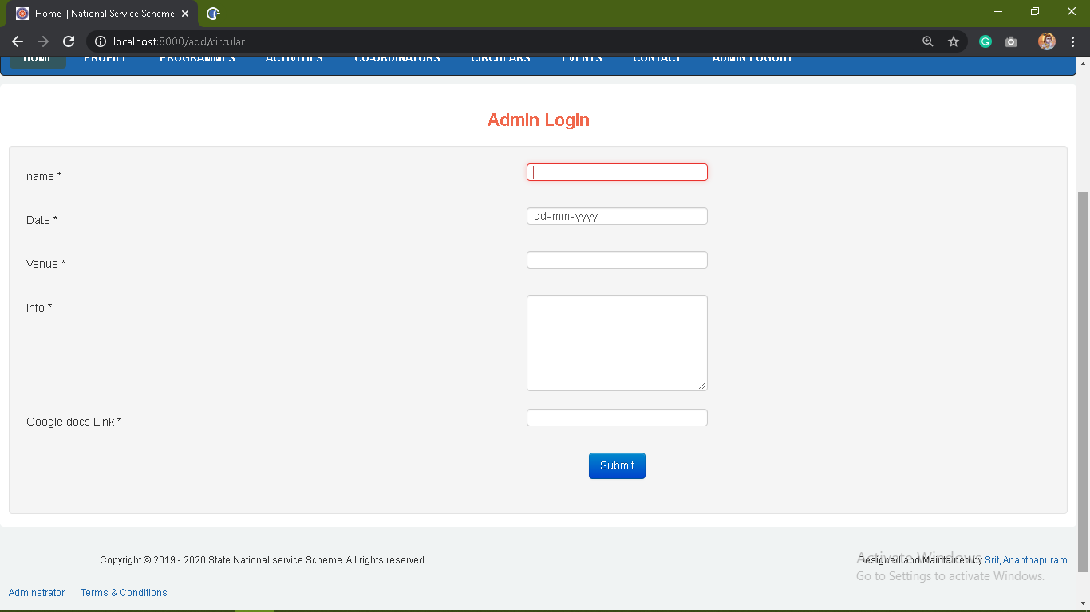
Admin-Add Circulars

Slide 21
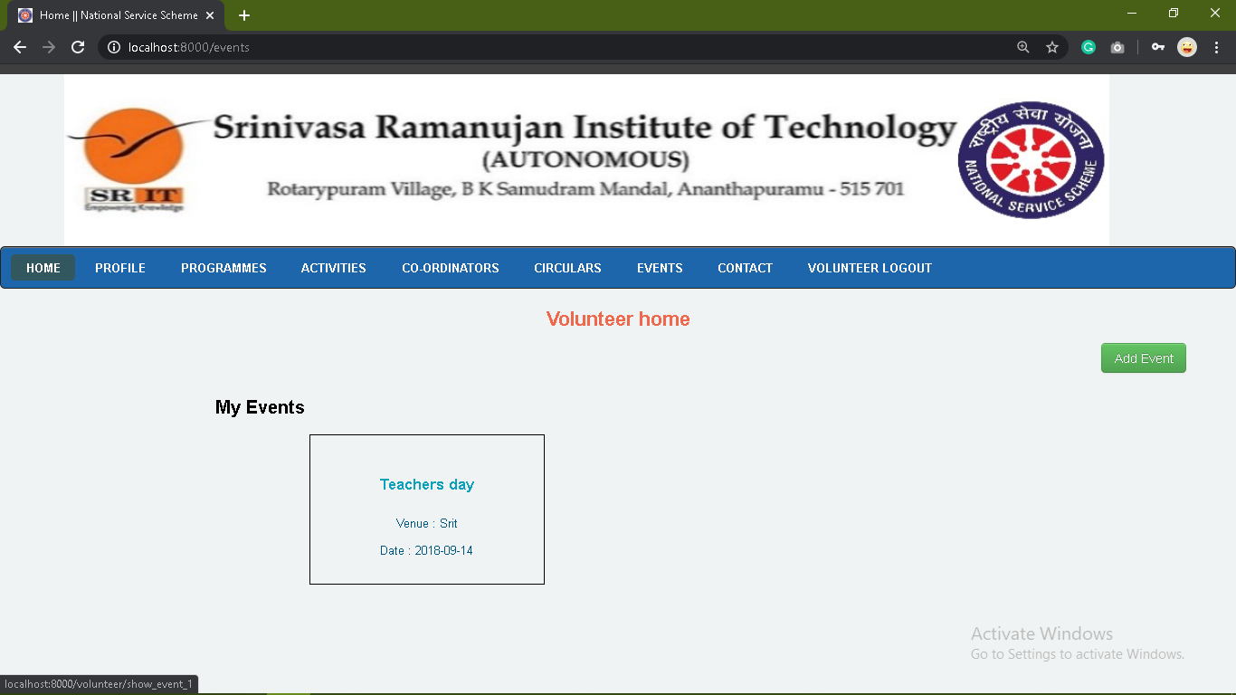
Volunteers- Add Events

Slide 22
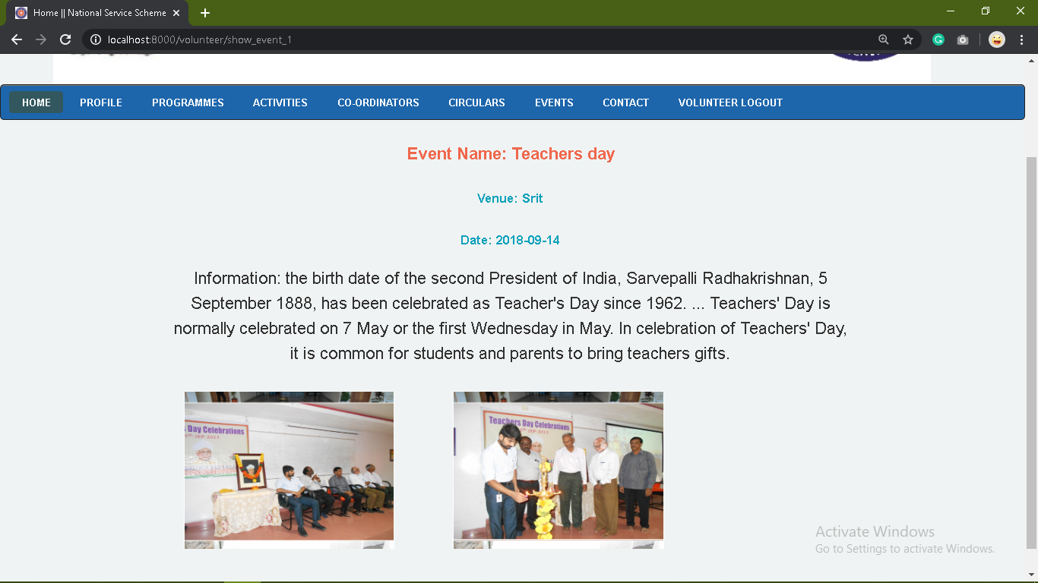
Cont...

Slide 23
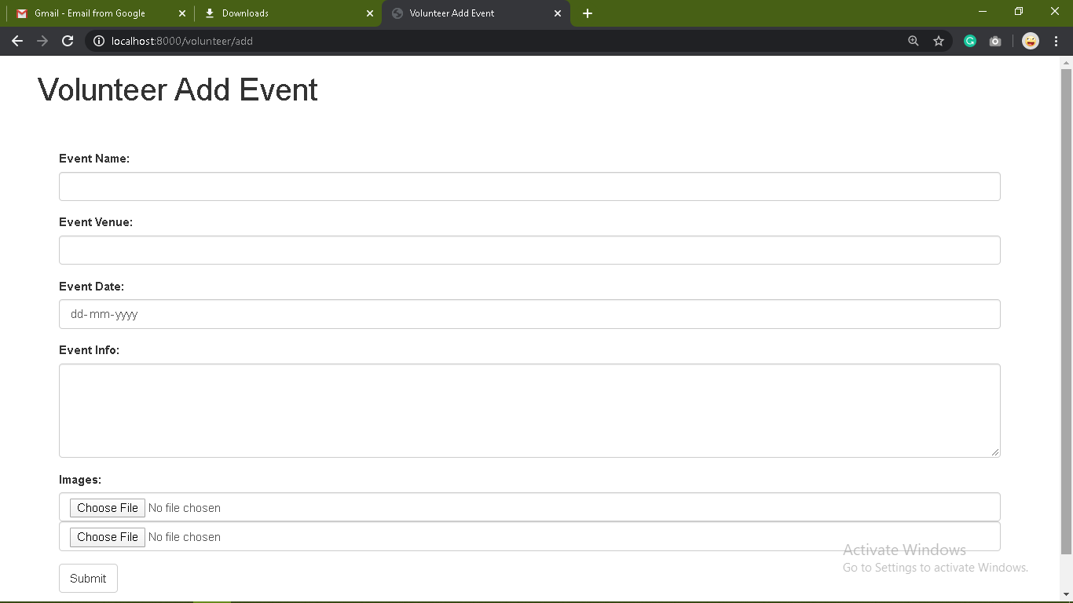
Add Event-Volunteer

Slide 24
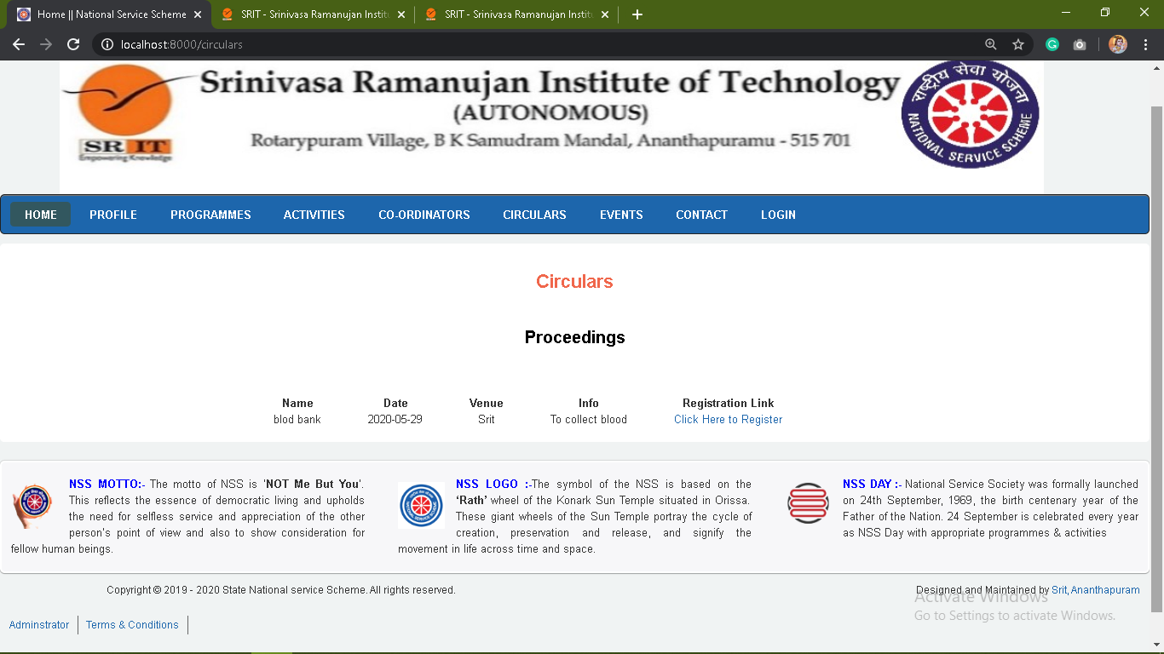
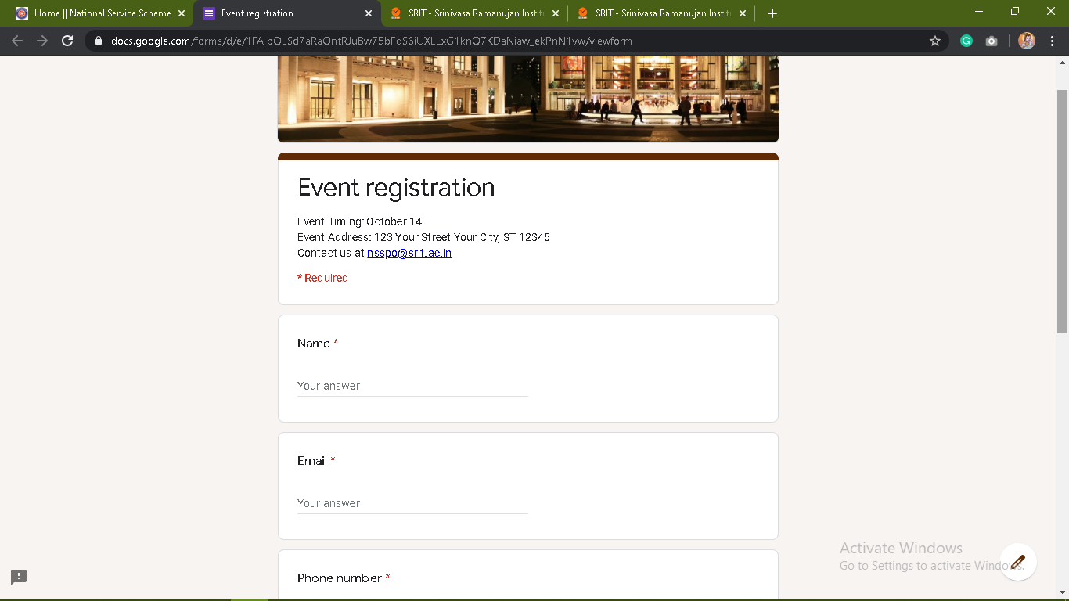
Student Module

Slide 25
References
http://nss.annauniv.edu
https://nss.gov.in
http://nsskerala.org
http://nssjntuk.org

Slide 26
Thank you
Queries
?

